Slide 1

Presentation By : Bhavya Batra
Committee Members : Dr. Susan Mengel (Chair)
Dr. Sepideh Ghanavati
Dr. Richard Watson
April 28th, 2017

Slide 2
The Blueprint
Introduction: SWE Origin
Introduction: SWE Operations
Introduction: SWE – OAWP
SWE-OAWP: Activity Diagram
SWE-OAWP: Design
SWE-OAWP: Architecture
SWE-OAWP: Class Diagram
SWE-OAWP: Use-Case Diagram
SWE-OAWP: Sequence Diagram
SWE-OAWP: Operation
SWE-OAWP: Testing
SWE-OAWP: What’s in the Future ?
SWE-OAWP: Related Works
SWE-OAWP: Now, Lets go Live !!
SWE-OAWP: Privacy

Slide 3
Introduction: The Beginning
1940, WWII
Women Group at Drexel, Cooper Union, City College of NY
After WWII
Elsie Eaves
May27-28, 1950
Dr. Batrice A. Hicks
1960, Russia’s Sputnik

Slide 4
Introduction: SWE-Operations
Professional Excellence
Globalization
Advocacy

Slide 5
Introduction: SWE-OAWP
Surveys Administration
Manage Feedbacks
Infographics
Users Administration
SWE Outreach Assessment Web Portal
Globalization

Slide 6
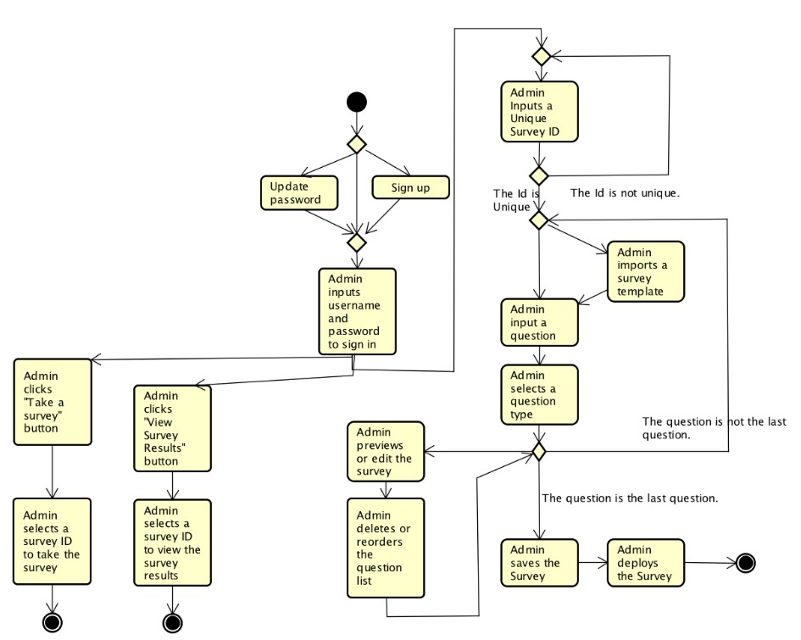
SWE-OAWP : Related Works
App Name : AutoSWE
Developed by YongJi Li
Under Dr. Susan Mengel,
May 2016

Slide 7
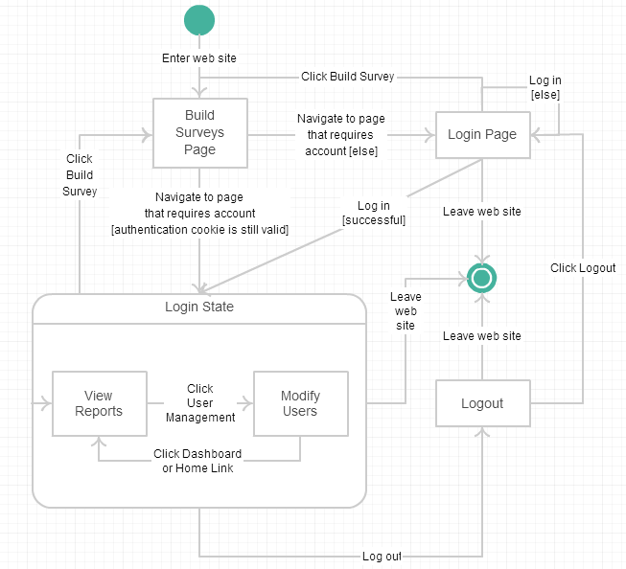
SWE-OAWP : Related Works
CS5364 project
Under Dr. Susan Mengel,
2014-2015

Slide 8



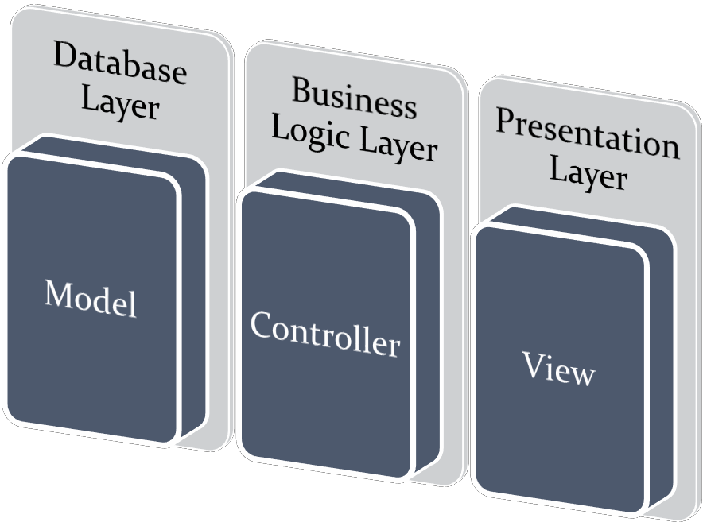
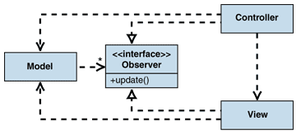
SWE-OAWP : The Design

Slide 9
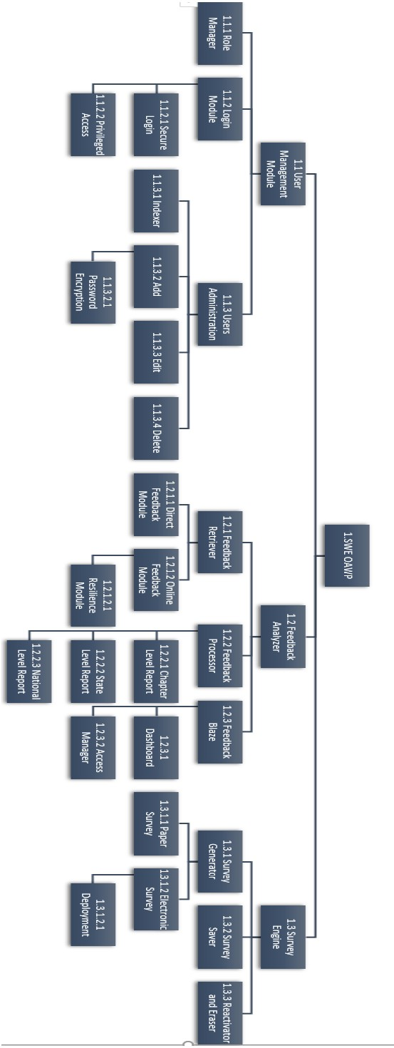
SWE-OAWP : Architecture

Slide 10
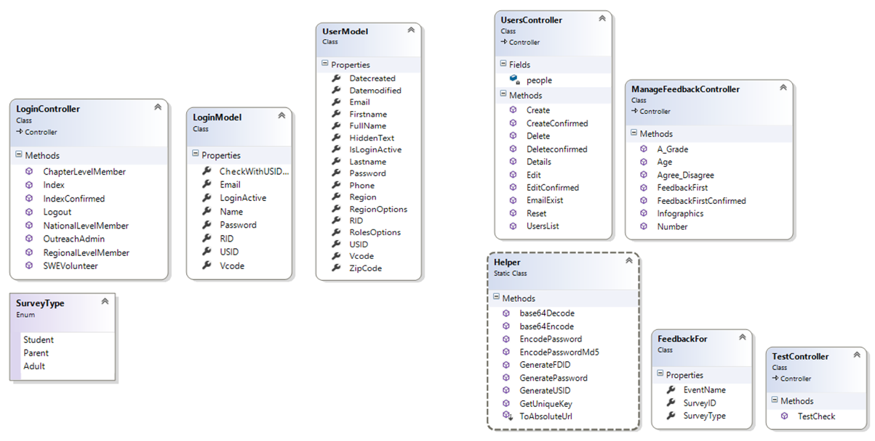
SWE-OAWP : Class-Diagram

Slide 11
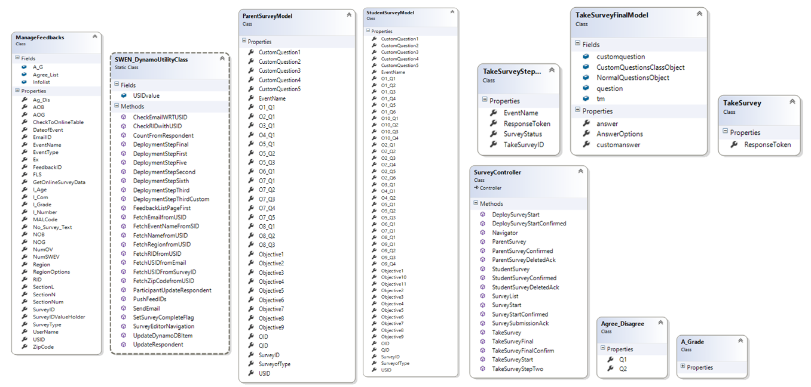
SWE-OAWP : Class-Diagram

Slide 12
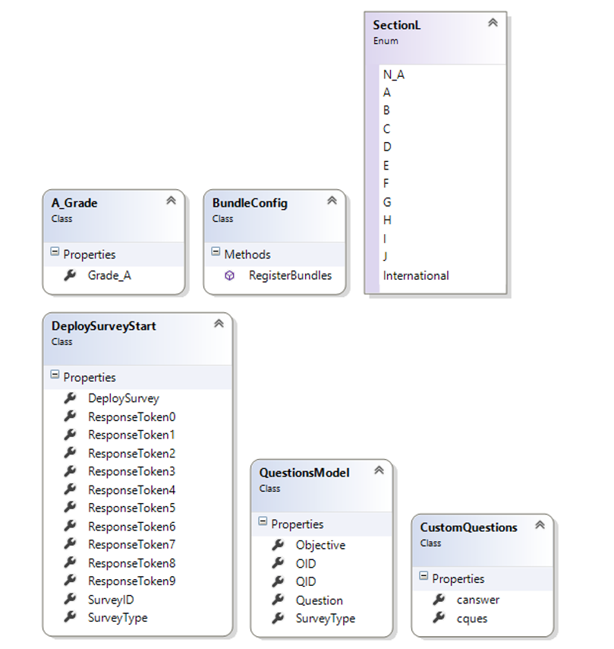
SWE-OAWP : Class-Diagram

Slide 13
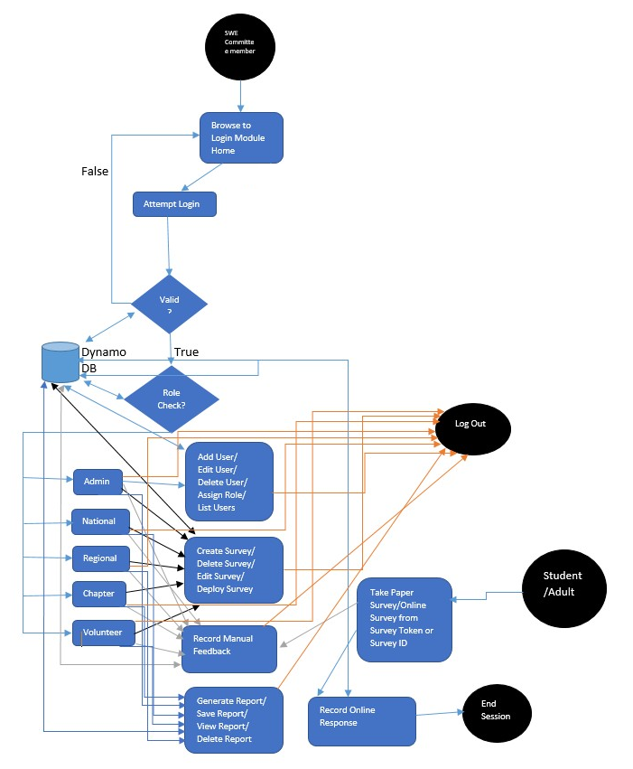
SWE-OAWP : Activity Diagram

Slide 14
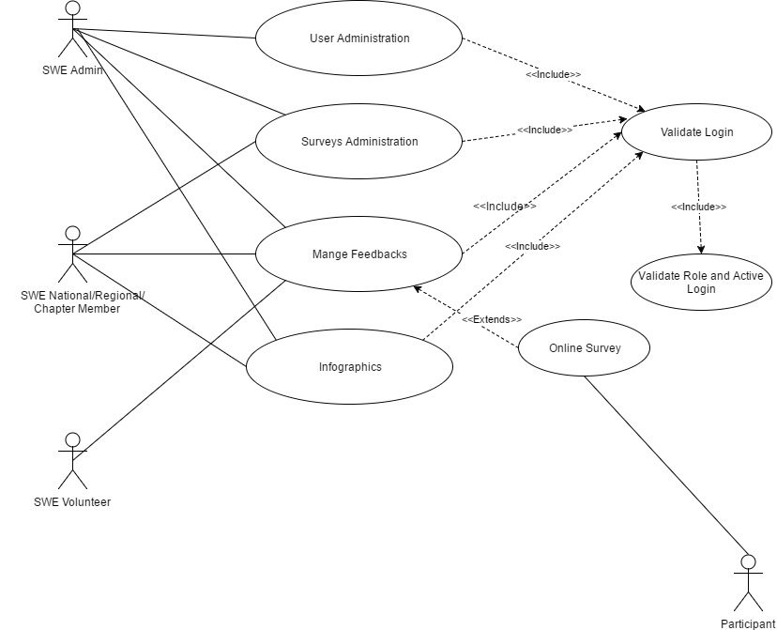
SWE-OAWP : Use-Case Diagram

Slide 15
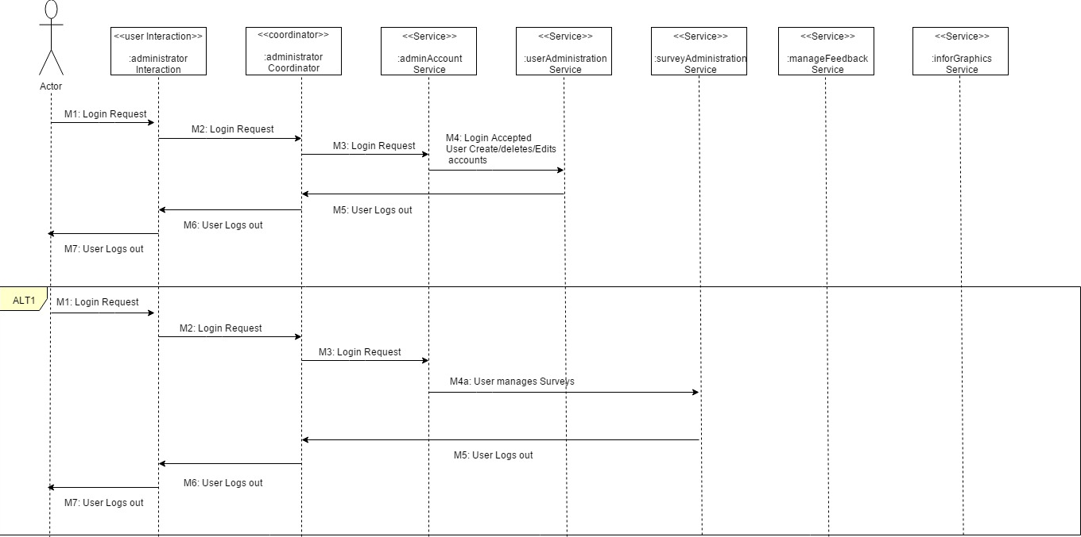
SWE-OAWP : Sequence Diagram

Slide 16
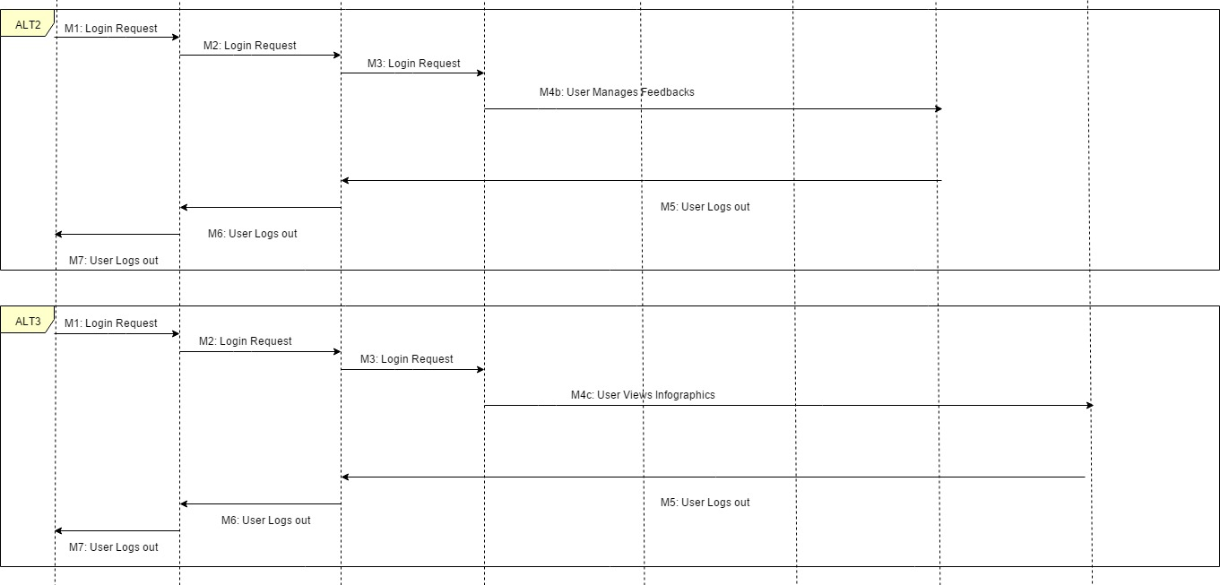
SWE-OAWP : Sequence Diagram

Slide 17
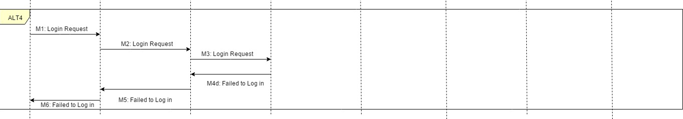
SWE-OAWP : Sequence Diagram

Slide 18
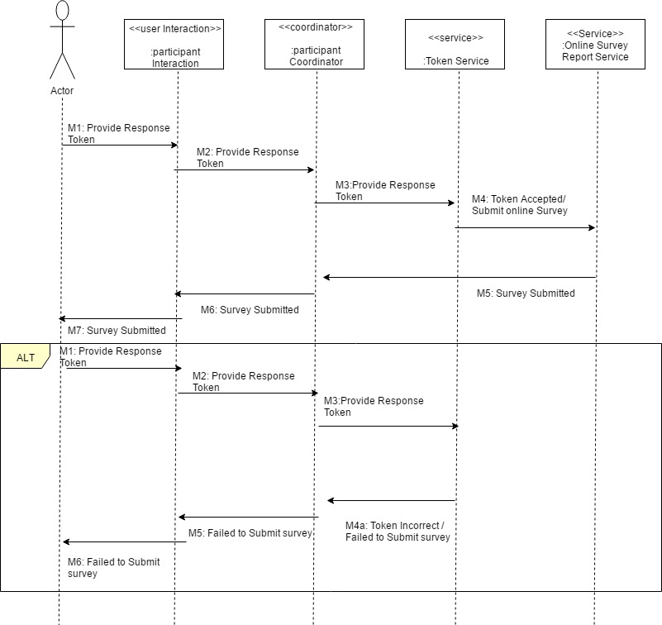
SWE-OAWP : Sequence Diagram

Slide 19
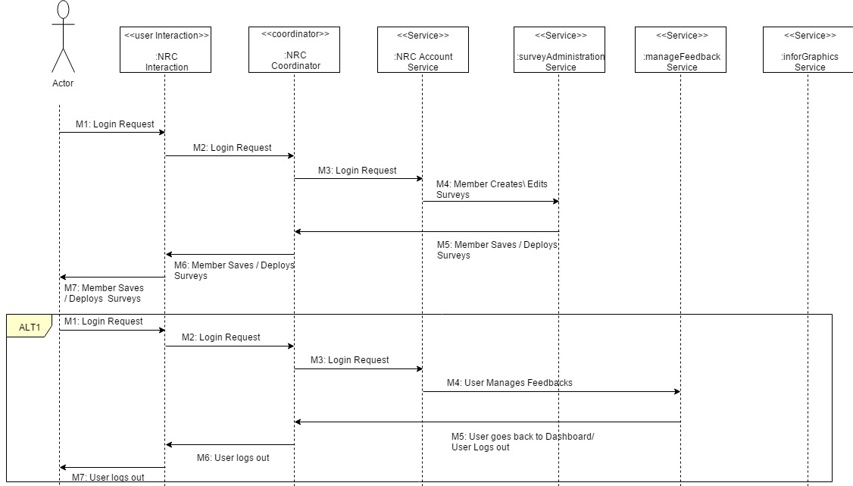
SWE-OAWP : Sequence Diagram

Slide 20
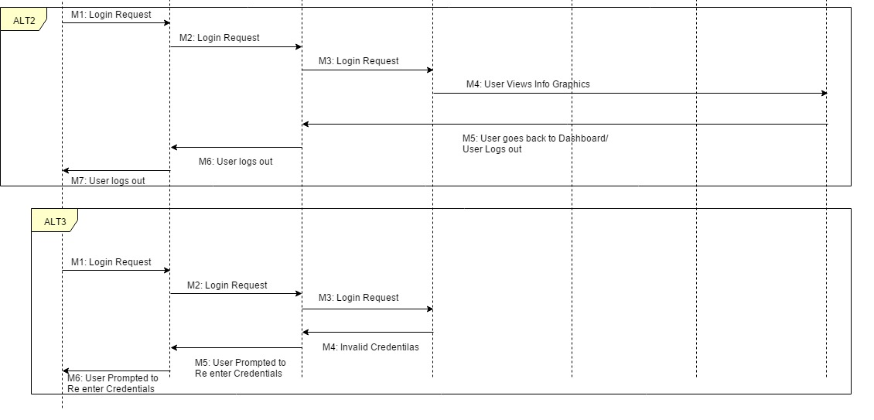
SWE-OAWP : Sequence Diagram

Slide 21
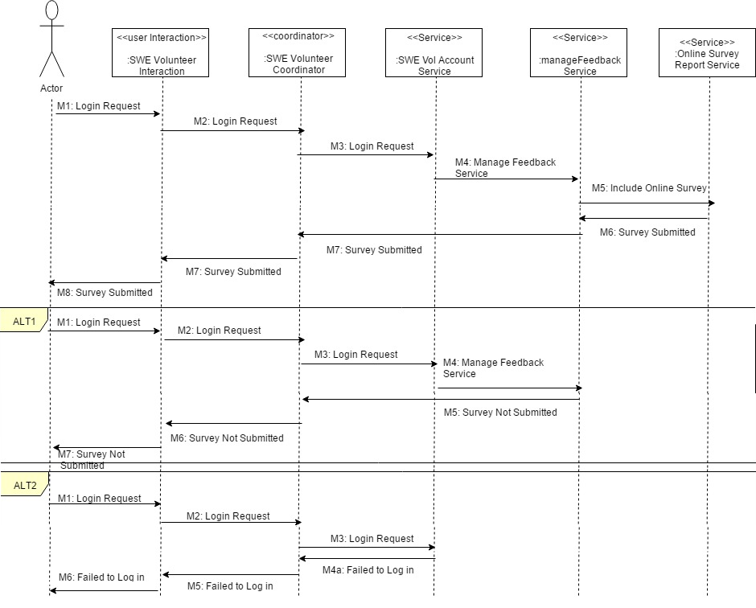
SWE-OAWP : Sequence Diagram

Slide 22
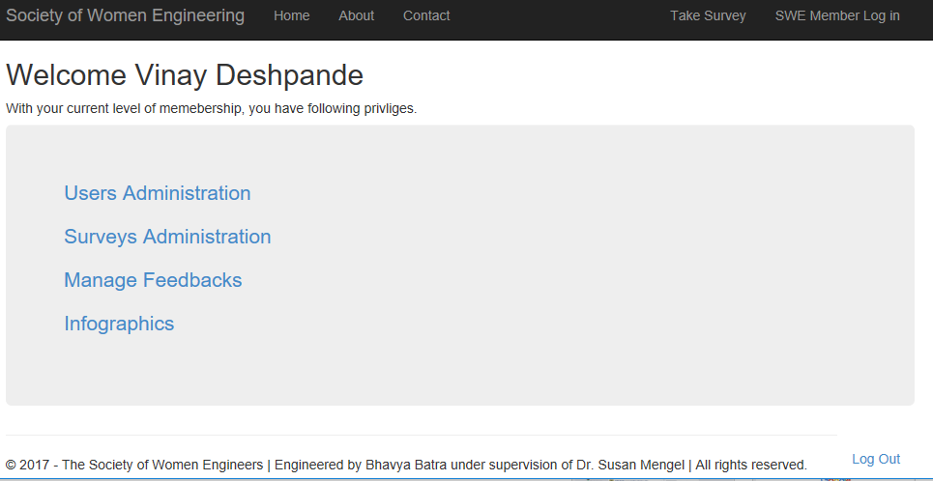
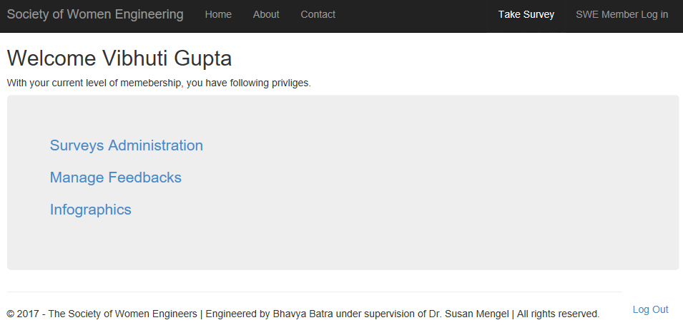
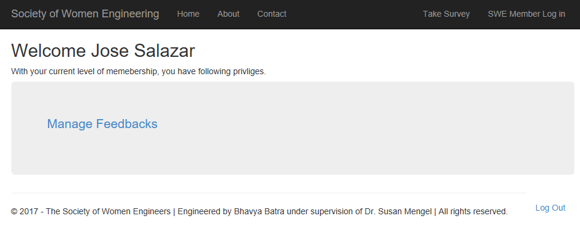
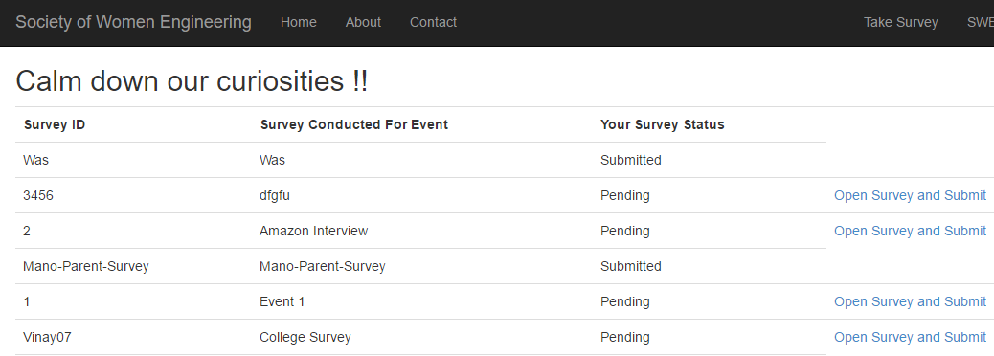
SWE-OAWP : In-Operation
Dashboards
Outreach Admin
National/Regional/
Chapter Level
Member
SWE Volunteer
Survey Participants

Slide 23
SWE-OAWP : Testing by Testers
#Number | Tester Name | Assigned Role | Department
1 | Vinay Deshpande | Outreach Admin | Computer Science
2 | Manohar Kotapati | National Level Admin | Computer Science
3 | Vibhuti Gupta | National Level Admin | Computer Science
4 | Abdullah Ejaz | Regional Level Admin | Computer Science
5 | Phani Cherukuri | Regional Level Admin | Computer Science
6 | Vidya Eswarappa | Chapter Level Admin | Computer Science
7 | Anjikya Tiwari | Chapter Level Admin | Computer Science
8 | Jose Salazar | SWE Volunteer | Law
9 | Gaurav Vinayaka | SWE Volunteer | Computer Science
10 | Mayuresh Indapurkar | SWE Volunteer | Data Science
11 | Tania Singh | Participant | Law
12 | Sara Khan | Participant | Law
13 | Arun Jegarkal | Participant | Computer Science
14 | Vinay Deshpande | Participant | Computer Science
15 | Bhavya Batra | Participant | Computer Science-SE

Slide 24
SWE-OAWP : Testing on Cases
#Test Case | Test Cases by Admin and other members | Test Cases by participants.
1 | Perform smoke testing for proper dashboards and logins, logouts. | Login to participant panel.
2 | Login with your User ID Provided . | Visible List of Submitted and pending Surveys.
3 | Login with your Email Provided. | No link to open Submitted Surveys.
4 | Put incorrect password for your login. | Opened pending surveys successfully.
5 | Check for name and appropriate links on dashboard e.g. admin should see Survey administration, Manage Feedback and Infographics links. | Answered Dropdown and Custom Questions successfully.
6 | Click on Survey Admin and create a "Student" survey. Select minimum 3 and maximum 5 head topics and then any number of questions in those topics. | Survey Submitted Successfully.
7 | Deploy Survey to following users :- “tania.singh@ttu.edu”,”sara.khan@ttu.edu”,”arun-kumar.jegarkal@ttu.edu”,”bhavyabatra88@gmail.com”,”vinay.deshpande18@gmail.com” | Survey Status changed from pending to submitted.
8 | Go back to survey List. | Submit a blank survey.
9 | Go to Manage Feedback and put random values for data. Select any survey with answers if available and submit feedback.
10 | Go Infographics Section. You should be able see all the graphs for all states (if data available for other states.)
11 | Do ad-hoc testing.
12 | Create random surveys, add and delete other surveys which are not deployed.
13 | Don’t include online surveys even if exist while giving feedbacks.

Slide 25

SWE-OAWP : Privacy
FTC Fair Information Practice
Awareness – “Take Survey”
Consent – “Response Token”
Choice – Unanswered Survey
Information is secure – Amazon Dynamo DB, Infographics, No Unique ID

Slide 26

SWE-OAWP : What’s in Future ?
Change Management Model : Objectives, Roles, User access controls, Questions.
Paper Survey Generation for latest file formats.
Live Infographics.
Collaborative graphs and downloadable formats.
UX/UI Design.
One click Link for participants using dedicated Email Relay Server.
International Level Members – Dashboard.

Slide 27
SWE-OAWP : LIVE
Lets go Live !!

